Slide 1

Business oriented web service application

Slide 2
About company
BizShot is a social news website primarily focusing on establishing a communication link between the investors and the startups with innovative ideas. It also provides service to the local business people to disseminate their business across the city, state, country or even globaly. It serves as a platform specifically for the business people to gather, communicate and to grow together.

Slide 3
Goal of site
For Investors - To find a perfect business idea and to invest money in the right business trend based on the current business trends in the news.
For ideas/talent persons - A platform to broadcast their ideas or talent to be recognised by the investors to bring their ideas to implementation.
For Business Expandors - They can post about their current business details and request for interested investors for further establishment of their business globally.

Slide 4
Website Goals
The visitors of the site should be able to see the articles in the Articles section about the current trends in the industry and also to ask the Questions on any doubts about their business in the dedicated Q&A section
The visitor can able to register and become a member of the site and this is achieved by providing a Signup option
Exisiting members can Login directly into the site with the Login option
Once the user has logged in they are directed to a dashboard view where they can search about a particular business ideas post or about any investors proposal on investing on a particular idea.

Slide 5
Website Goals

Slide 6
Brainstorming
stock exchange
talent
Skill
legal
Resources
Finance
Funding
Trending analysis
Partner
Innovative ideas
Donate
Bigshot investors
Crowdfunding
Investment
Capital
Initial Public offering
Business
Business strategies
Organisation
Startup
Product
Service
Marketing
Share
Agreement
Investing
Business Expansion
Global
Local
Subsidaries
Trade
Sales
Manufacturing
Acquisition
Mergers
Economic value
Net worth
Comparison
Conglomerate
Research and developement
Enterprise
Corporate group
Intellectual property

Slide 7
Competitor analysis
Justdial
Naukri
Urban clap
Monster jobs

Slide 8
Target Audience

Slide 9
Information Architecture

Slide 10
Sitemap

Slide 11
Wireframe

Slide 12
Blocking

Slide 13
Prototype

Slide 14
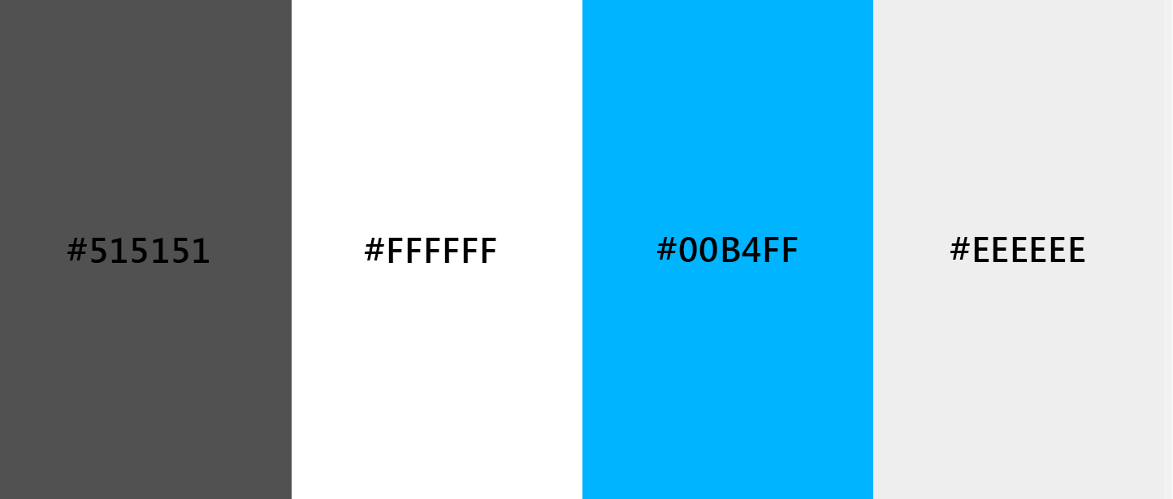
Theme
Blue
Neutrals
Hex codes - #515151
#FFFFFF, #00B4FF
#EEEEEE

Slide 15
Typography
Heading - Lato
Sub heading -Lato
Body content - Roboto

Slide 16
Competitor Websites
Urbanclap - https://www.urbanclap.com/
Facebook - https://www.facebook.com/
Twitter - https://twitter.com/
Linkedin -
Instagram -
Meetup - https://www.meetup.com/
Foursquare -
Yelp -

